Slide 1
ALZHEIMER'S AND OTHER DEMENTIAS
OPIO JOEL
G COHES

Slide 2
OUTLINE
Introduction/ definitions
Epidemiology
Etiology/ Pathophysiology
Clinical features
Diagnostic criteria
Treatment
Other dementias

Slide 3
Introduction
Dementia is defined as a progressive impairment of cognitive functions occurring in clear consciousness (i.e., in the absence of delirium)
Dementia is a syndrome of acquired deterioration in cognitive ability that impairs successful performance of acquired activities of daily leaving beyond what might be expected from normal aging.
Neurodegeneration is the progressive loss of structure or function of neurons, including death of neurons.
Alzheimer’s disease occurs as a result of neurodegenerative processes.

Slide 4
Introduction
Dementia First described by Prof Alois Alzheimer in 1907 in a 55 y/o German woman (Auguste Deter) with a 4 ½ years course of progressive dementia.
Dementia( taken from latin, meaning “madness” from de- “without” and ment – mind.
Dementia in DSM 5, is under NEUROCOGNITIVE DISORDERS and is termed;
MAJOR Neurocognitive Disorder

Slide 5
Classification of AD
Early Onset Familial AD – linked to 3 genes
APP gene on Xsome 21 is most implicated
Presenelin 1 on Xsome 14 (earlier onset than the rest)
Presenilin 2 on Xsome 1
Late Onset AD
Apolipoprotein E (ApoE) 4 allele.
Notes:
Early-onset Alzheimer's that runs in families is linked to three genes — the APP, PSEN 1 and PSEN 2. A genetic mutation in one of those three genes, you may develop Alzheimer's before age 65.
APP- Amyloid Precursor Protein

Slide 6
Prevalence
The prevalence of overall dementia (major NCD) rises steeply with age.
Dementia affects around 47m people worldwide & incidence is expected to double every 20 years (Prince 2015)
Around 60-90% of all dementia cases are caused by AD (DSM5)
2/3 of those diagnosed with AD are women.

Slide 7
Prevalence…..
U.S. census data estimates suggest that approximately 7% of individuals diagnosed with Alzheimer's disease are between ages 65 and 74 years, 53% are between ages 75 and 84 years, and 40% are 85 years and older.
In Uganda, a 6.3% of dementia among elderly patients on non-psychiatric wards (Nakasujja et al., 2007)
Advancing age is a primary risk factor for the disease : every 5 years after the age of 65, the risk of acquiring the disease approximately doubles

Slide 8
Etiology/Neuropathology
Genetics….40% of Patients with AD have familial Hx.
Concordance rate for monozygotic twins is higher than the rate for dizygotic twins(43% vs. 8%)
20% linkage to chromosomes 1, 14, and 21. Presenilin 1 on chromosome 14, Presenilin 2 on chromosome 1, APP on chromosome 21.
Apo E4 gene – xsome 19 implicated in late onset AD.
Notes:
LOAD- Late Onset AD

Slide 9
Etiology/Neuropathology
Cholinergic Hypothesis --- which proposes that AD is caused by reduced synthesis of the neurotransmitter acetylcholine.
Excessive stimulation by the Glutamate that may damage neurons

Slide 10
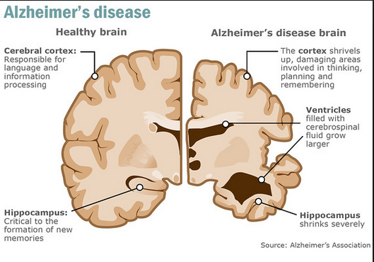

Slide 11
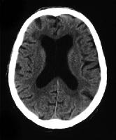
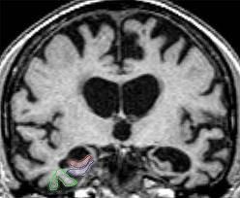
Diffuse cerebral atrophy with enlargement of the ventricle seen on CT scan and MRI

Slide 12
Other notable pathology
Diffuse cortical atrophy
Flattened cortical sulci
Enlarged cerebral ventricles
Reduction of temporal- parietal and hippocampal cortical activity of choline acetyltransferase.
Neuronal loss particularly in the cortex and hippocampus

Slide 13
Risk and prognostic factors
Environmental. Traumatic brain injury increases risk for major or mild NCD due to Alzheimer's disease.
Genetic and physiological.
Age is the strongest risk factor.
The genetic susceptibility.
Individuals with Down's syndrome (trisomy 21) develop Alzheimer's disease if they survive to midlife.
Multiple vascular risk factors and cerebrovascular pathology.

Slide 14
Clinical features
Early stages:
memory loss
Cognitive problems
Middle stages:
Cognitive problems worsen
Cortical blindness
Late stages:
Complete loss of cognitive abilities
Hallucinations & delusions
Social withdrawal
Shuffling gait
Remain ambulatory
End stage:
Mute, incontinent, bedridden.
Hyperactive tendon reflexes
Primitive sucking and snouting reflexes.
Myoclonic jerks
Seizures
Death

Slide 15
Early Stages of AD
In people with AD the increasing impairment of learning and memory eventually leads to a definitive diagnosis.
Older memories of the person's life (episodic memory), facts learned (semantic memory), and implicit memory (skills) are affected to a lesser degree than new facts or memories.
In a small portion of them, difficulties with language, executive functions, perception or execution of movements are more prominent than memory problems.
Language problems are mainly characterized by a shrinking vocabulary and decreased word fluency.
Can perform activities independently but need supervision for more cognitively demanding activities.

Slide 16
Middle stages of AD
Progressive deterioration eventually hinders independence; with subjects being unable to perform most common activities of daily living.
Common manifestations are wandering, irritability and labile affect, leading to crying, outbursts of unpremeditated aggression, or resistance to care giving. Sun downing can also appear.
Approximately 30% of people with AD develop illusions and other delusional symptoms.
Subjects also lose insight of their disease process and limitations (anosognosia).

Slide 17
Late stages of AD
The person is completely dependent upon caregivers. Language is reduced to simple phrases or words, eventually leading to complete loss of speech.
Despite the loss of verbal language abilities, people can often understand and return emotional signals.
Although aggressiveness can still be present, extreme apathy and exhaustion are more common.
People with AD will ultimately not be able to perform even the simplest tasks without assistance.
Muscle mass and mobility deteriorate to the point where they are bedridden, and they lose the ability to feed themselves.
AD is a terminal illness, with the cause of death typically being an external factor, such as infection of pressure ulcers or pneumonia, not the disease itself.

Slide 18
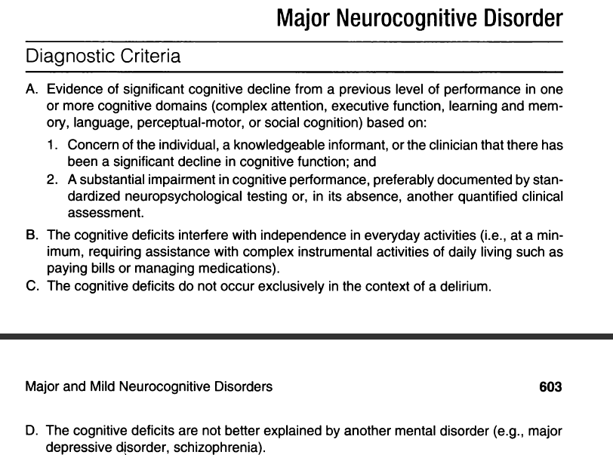
DSM 5

Slide 19
Diagnosis
Alzheimer's disease is usually diagnosed clinically from the
patient history
collateral history from relatives
clinical observations
based on the presence of characteristic neurological and neuropsychological features and the absence of alternative conditions.
Advanced medical imaging with CT or MRI, and with PET can be used to help exclude other cerebral pathology or subtypes of dementia.
Assessment of intellectual functioning including memory testing can further characterize the state of the disease.
The diagnosis can be confirmed on postmortem
Notes:
single photon emission computed tomography (SPECT) or positron emission tomography (PET)

Slide 20
Investigations for dementia
F.B.C.
E.S.R.
Urea & Electrolytes
LFT’s / bone chemistry
Random / fasting blood glucose
Blood serology
Thyroid function tests
B12 and Folate levels
Chest X-ray
ECG
CT Scan

Slide 21
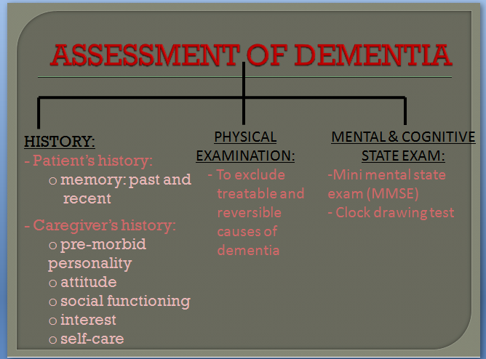

Slide 22
Management of Dementias
General principles
Non pharmacological
intervention
Pharmacological treatment
Set treatment goals
Involve patient and family members in decision making
Treat the main distressing problem first
Set a frame time: monitor cognitive & non cognitive symptoms
Assess success/failure of the intervention

Slide 23
General principles
1.Treatment goals:
consider modified living situations or housing options to ensure patient safety.
provide reassurance, support, and familiarity to the patient.
2. Treat the main distressing problem first:
evaluate suicidal risk
evaluate potential violence
recommend adequate supervision
prevention of falls
minimize hazards of wandering
restriction of driving/use of dangerous equipment

Slide 24
Non Pharmacological Interventions
GENERAL PSYCHOSOCIAL
Educate the patient and family.
Optimize function & QOL.
Address family issue: financial, emotional.
Related forensic issues.
Promoting independence: communication, ADL skill training, exercise, rehabilitation.
Maintenance of cognition, life review
SPECIFIC PSYCHOTHERAPY
Behavior-oriented.
Emotion-oriented
Cognition oriented
Stimulation oriented

Slide 25
Pharmacological Interventions
COGNITIVE IMPROVEMENT:
Cholinesterase inhibitor:
- Donepezil (5-10mg od)
-Rivastigmine(1.5-3mg bd)
- Galantamine(4-12mg bd)
NMDA antagonist:
-Memantine(5-20mg od)
BEHAVIOURAL & PSYCHOLOGICAL SYMPTOMS:
Psychosis & agitation- atypical antipsychotics
Depression – Antidepressants
Sleep disturbance
Notes:
COGNITIVE IMPROVEMENT:
- NMDA antagonist: Memantine(5-20mg od)

Slide 26
Other Dementias

Slide 27
Vascular dementia
Vascular dementia is a type of dementia that is caused by disease or injury to blood vessels in the brain, mostly strokes.
The exact symptoms of this dementia depend on where in the brain the strokes have occurred and whether the vessels are large or small.
On scans of the brain, a person with vascular dementia may show evidence of multiple different strokes of different sizes.
They also may have risk factors for artery disease such as tobacco smoking, high blood pressure, atrial fibrillation, high cholesterol or diabetes.
He or she might also have other signs of blood vessel disease such as a previous heart attack or angina.

Slide 28
Other forms;
Multi-infarct Dementia:
-Occurrence of multiple cerebral infarctions can lead to a progressive disruption of brain function, leading to dementia.
An abrupt onset,
- Acute exacerbations (due to repeated infarctions),
- Stepwise clinical deterioration (step-ladder pattern),
- Fluctuating course,
- Presence of hypertension (most commonly) or any other significant cardiovascular disease, and
- History of previous stroke or transient ischemic attacks (TIAs).

Slide 29
DIFFERENTIATING FEATURES | ALZHEIMER’S DISEASE | VASCULAR DEMENTIA
ETIOLOGY | Genetic Neuropathology Neurotransmitter | Hypertension Other cardiovascular risk
AGE OF ONSET | Usually > 65 y/o | Less common in those > 75 y/o
ONSET OF SYMPTOMS | Insidious | Abrupt
COURSE OF ILLNESS | Steady progression in function decline | Worsening dementia
PATTERN OF COGNITIVE DEFICIT | Global | Patchy: depending on the area of the brain affected
RADIOLOGICAL FINDINGS | Diffuse cerebral atrophy with ventricle enlargement | Multifocal infarcts

Slide 30
Lewy Body Dementia
First Symptom- Visual hallucinations, REM sleep disorder, delirium, parkinsonism.
Mental Status: spares memory; delirium prone.
Neuropsychiatry :Visual hallucinations, depression, sleep disorder, delusions.
Neurology: Parkinsonism.
Imaging: Posterior parietal atrophy; hippocampi larger than in AD.

Slide 31
Lewy Body Dementia
Considered to be the second most common cause of the degenerative dementias, accounting for about 4% of all dementias.
Has the primary symptoms of visual hallucinations and "Parkinsonism (includes tremor, rigid muscles, and a face without emotion.
The visual hallucinations in DLB are generally very vivid hallucinations of people and/or animals and they often occur when someone is about to fall asleep or just waking up.

Slide 32
Lewy Body Dementia
Other prominent symptoms include problems with attention, organization, problem solving and planning (executive function).
Generally, a diagnosis of DLB is straightforward and unless it is complicated; a brain scan is not always necessary.
Antipsychotic medication should be avoided (or used with extreme caution and in low doses) in patients with Lewy body dementia.

Slide 33
Frontotemporal Dementia (FTD)
First Symptom-Apathy; poor judgment/insight, speech/language; hyperorality
Mental Status-Frontal/executive function loss, language.
Neuropsychiatry :Apathy, disinhibition, hyperorality, euphoria, depression (Behavioral variant shows, early decline in personal & interpersonal conduct.
Imaging: Atrophy; spares posterior parietal lobe

Slide 34
AIDS Dementia Complex
-About 50-70% of patients suffering from AIDS exhibit a triad of cognitive, behavioral and motor deficits of subcortical dementia type.
-As the AIDS virus is highly neurotropic and it crosses the blood-brain barrier early in the course of the disease.
-Cognitive impairment is very common in AIDS.
-The diagnosis is established by ELISA showing anti-HIV antibodies test.

Slide 35
Pseudodementia
A presentation of severe depression in the elderly where the combination of psychomotor retardation, apparent cognitive deficits, and functional decline causes diagnostic confusion with dementia.
Features
Previous history of depression
Depressed mood and cognition.
Poor concentration
No confabulation
Don’t know or approximate answer
No neurological signs

Slide 36
References
The diagnosis of dementia due to Alzheimer’s disease:
Recommendations from the National Institute on Aging-
Alzheimer’s Association workgroups on diagnostic guideline for Alzheimer’s disease
Psychiatrys clerkship, student guide.

